Slide 1
…τα κοινωνικά δίκτυα
α ν α δ ε ι κ ν ύ ο υ ν
ένα μαθητικό διαγωνισμό
δημιουργικής γραφής και φιλαναγνωσίας
Β. Οικονόμου, Α. Κόντα, Π. Τζαφέρου, Σ. Κολιοπούλου, Γ. Τσούκας
Notes:
Computer Science Courses
Cross-curriular activities
Teacher’s Support - Training
Project Based Student’s Work
Portals
R&D programs
Educational Software Development
Technical Support
MIS

Slide 2
Όταν τα κοινωνικά δίκτυα
αξιοποιούνται
στην εκπαιδευτική διαδικασία
τα αποτελέσματα είναι εκπληκτικά!
Notes:
Computer Science Courses
Cross-curriular activities
Teacher’s Support - Training
Project Based Student’s Work
Portals
R&D programs
Educational Software Development
Technical Support
MIS

Slide 3
Η χρήση των δυνατοτήτων:
μιας πλατφόρμας δημιουργίας blogs
μιας εφαρμογής δημιουργίας διαδικτυακών ερωτηματολογίων
και αυτών της ψηφοφορίας θεμάτων μέσω διαδικτύου
Notes:
Computer Science Courses
Cross-curriular activities
Teacher’s Support - Training
Project Based Student’s Work
Portals
R&D programs
Educational Software Development
Technical Support
MIS

Slide 4
…το μεράκι για προσφορά των τεχνολογιών
στην εκπαιδευτική διαδικασία
Notes:
Computer Science Courses
Cross-curriular activities
Teacher’s Support - Training
Project Based Student’s Work
Portals
R&D programs
Educational Software Development
Technical Support
MIS

Slide 5
…μας οδήγησαν στη σχεδίαση και υλοποίηση
ενός διαγωνισμού μέσω διαδικτύου
για τους μαθητές του Δημοτικού μας σχολείου
Notes:
Computer Science Courses
Cross-curriular activities
Teacher’s Support - Training
Project Based Student’s Work
Portals
R&D programs
Educational Software Development
Technical Support
MIS

Slide 6
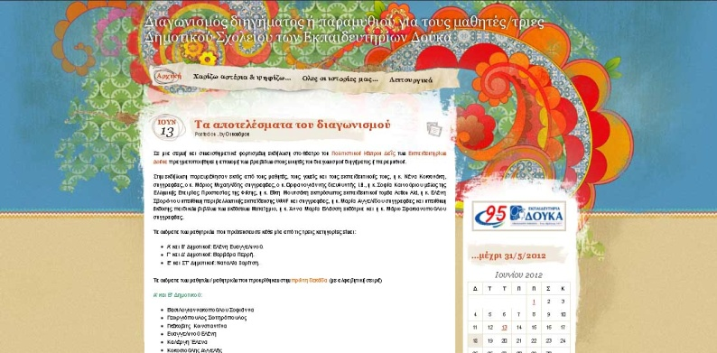
diigima.wordpress.com
Notes:
Computer Science Courses
Cross-curriular activities
Teacher’s Support - Training
Project Based Student’s Work
Portals
R&D programs
Educational Software Development
Technical Support
MIS

Slide 7
Βασικοί στόχοι
Η δημιουργική προσέγγιση της γραφής
Μέσα από τα παραμύθια και τα διηγήματα τα παιδιά:
να εκφράσουν σκέψεις,
προβληματισμούς,
συναισθήματα
και όνειρα…
Η δημιουργική και ασφαλής προσέγγιση του διαδικτύου
Η ενίσχυση της φιλαναγνωσίας
Notes:
Computer Science Courses
Cross-curriular activities
Teacher’s Support - Training
Project Based Student’s Work
Portals
R&D programs
Educational Software Development
Technical Support
MIS

Slide 8
Ο διαγωνισμός …με αριθμούς
Notes:
Computer Science Courses
Cross-curriular activities
Teacher’s Support - Training
Project Based Student’s Work
Portals
R&D programs
Educational Software Development
Technical Support
MIS

Slide 9
161
Δημιουργίες
Notes:
Computer Science Courses
Cross-curriular activities
Teacher’s Support - Training
Project Based Student’s Work
Portals
R&D programs
Educational Software Development
Technical Support
MIS

Slide 10
30
Προκριθέντες
Notes:
Computer Science Courses
Cross-curriular activities
Teacher’s Support - Training
Project Based Student’s Work
Portals
R&D programs
Educational Software Development
Technical Support
MIS

Slide 11
71.300 Επισκέψεις
Notes:
Computer Science Courses
Cross-curriular activities
Teacher’s Support - Training
Project Based Student’s Work
Portals
R&D programs
Educational Software Development
Technical Support
MIS

Slide 12
7.760
Ψήφοι
Notes:
Computer Science Courses
Cross-curriular activities
Teacher’s Support - Training
Project Based Student’s Work
Portals
R&D programs
Educational Software Development
Technical Support
MIS

Slide 13
3
Νικητές
Notes:
Computer Science Courses
Cross-curriular activities
Teacher’s Support - Training
Project Based Student’s Work
Portals
R&D programs
Educational Software Development
Technical Support
MIS

Slide 14
800
Χαμόγελα
Notes:
Computer Science Courses
Cross-curriular activities
Teacher’s Support - Training
Project Based Student’s Work
Portals
R&D programs
Educational Software Development
Technical Support
MIS

Slide 15
…τα κοινωνικά δίκτυα
α ν α δ ε ι κ ν ύ ο υ ν
ένα μαθητικό διαγωνισμό
δημιουργικής γραφής και φιλαναγνωσίας
Β. Οικονόμου, Α. Κόντα, Π. Τζαφέρου, Σ. Κολιοπούλου, Γ. Τσούκας
Notes:
Computer Science Courses
Cross-curriular activities
Teacher’s Support - Training
Project Based Student’s Work
Portals
R&D programs
Educational Software Development
Technical Support
MIS

